Slide 1
RIVERA REAL ESTATE . WORKING NOTES
Second Commercial
Property Acquisition
A plan to add a second small mixed use building near Paterson by the end of 2027
Private working notes, Jason Rivera . reviewed with Selim Basaran on the legal side

Slide 2
WHY NOW
What the first building proved
$385K to $520K
Van Houten value since 2020
roughly $135K of appreciation in five years
$14,200
Net cash flow per year
after mortgage, taxes, and insurance
$220K
Equity built
the down payment engine for number two
The model works: buy a sound mixed use building, self manage it, let Selim handle the leases, and let the rent carry the mortgage. A second building near the Main Street kitchen repeats that and builds toward the long game.
2 / 7

Slide 3
THE BOX
Target criteria
Criterion | Target | Why it matters
Price range | $400,000 to $600,000 | Fits a 25% down payment from reserves
Units | Two to four, mixed use | Retail income plus a residential unit
Cap rate at current rents | 7% or better | Cash flow from day one
Distance from Main Street | Within 15 minutes | Self management stays practical
Condition | Sound roof and systems | No major deferred work
Tenants | Clean payment history | Income that is real, not hoped for
3 / 7

Slide 4
THE MONEY
How a $500,000 deal gets funded
Down payment, 25%
About $125,000 from distributions and the reserve account
Commercial loan, 75%
Talk to Valley National and TD once a building is identified
Emergency fund
Stays untouched at $42,000, this is a rule
Trigger
Move after the Wayne equipment loan is paid off in December
4 / 7

Slide 5
SCANNING
Cap rate on three watch list buildings
Only the buildings at or above 7% get a real underwriting pass. Prospect Park looks strong on paper and goes to the top of the list to walk with Selim.
5 / 7

Slide 6
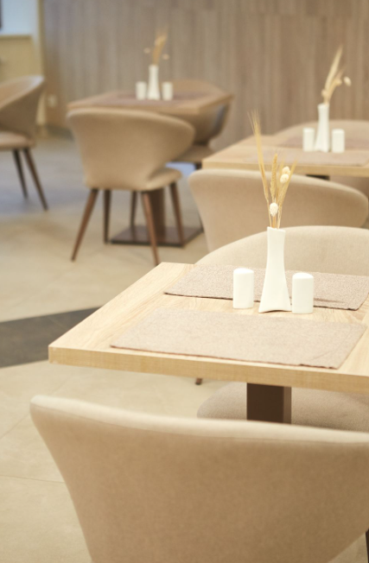
PATH
From watch list to keys
Now
Loopnet daily, NJ commercial meetups, ask Selim for off market leads
Dec 2026
Wayne equipment loan paid off, free up cash flow
Early 2027
Underwrite shortlisted buildings, run cap rate before getting attached
End 2027
Close on the right building, 25% down, repeat the model
6 / 7

Slide 7
Patient money, one building at a time
The first building was nine years of discipline. The second is the same playbook with more equity behind it. No stretching the household, no touching the emergency fund, no deal that does not clear 7%.
Goal: a second commercial property by the end of 2027.

